Slide 1
Cat Math
We are the Tic-Tacs:
Abit Kumar Mahato - MCS
Ben Hawk - CEG
Jessica Venema - BS in CS
Ethan Schultz - CS
Liliane Owens - CS
Presented by Tic–Tacs on Dec, 03 2024

Slide 2
Elevator Pitch
•We want to create an app for kids to improve their math skills and have fun while playing it
•There exists many apps to fulfill this task, such as Smart Tales, Math Learner, Math Games, and Todo Math.
•Our proposed solution is Cat Math. We chose this name because even hearing it will intrigue you to investigate the app.
•Our app features engagement through the use of experience systems, fun game modes, user customization, and appealing design.

Slide 3
Overview
The App is made up of five main components:
Main Menu
Grants easy access to all components
Experience System
Provides incentive and keeps users engaged
Calculator Mode
Functions as a useful tool to perform quick calculations
Math Problems Mode
Allows users to practice their ability to solve simple equations
Math Drills Mode
A timed mode for users to test their quick thinking skills

Slide 4


Main Menu
As a User, I want to open the app and feel excited to play the games.
The Main Menu shall display the User’s current XP as well as give quick access to all modes.
The background and buttons of the Main Menu shall be colorful while not being distracting.
The Main Menu has options for the Calculator, Math Drill, and Math Problems modes.

Slide 5
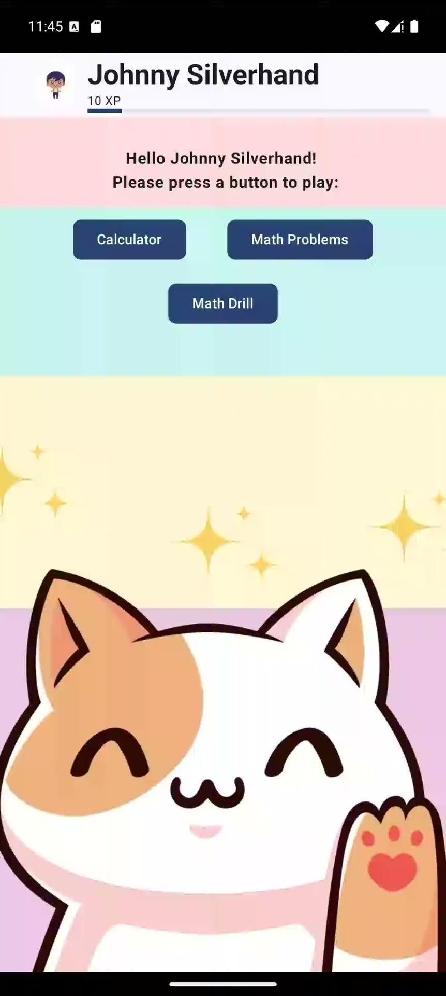
User Experience
As a user I want to earn experience points (XP) to experience both and achievement and receive an avatar.
Users shall receive XP for using the calculator, as well as for correctly answering problems in the Math drills and Math problems modes.
The user’s level will increase by a flat amount for the calculator mode, and will increase for every question they answer correctly in the Math Problem and Math Drill modes

Slide 6
Calculator Mode
As a User, I want to use the calculator mode to help me check my homework questions.
The calculator shall support two variable addition, subtraction, multiplication, and division for integer variables as well as decimals.
The calculator will display all of the numbers and operation entered by the user, as well as the final result.

Slide 7
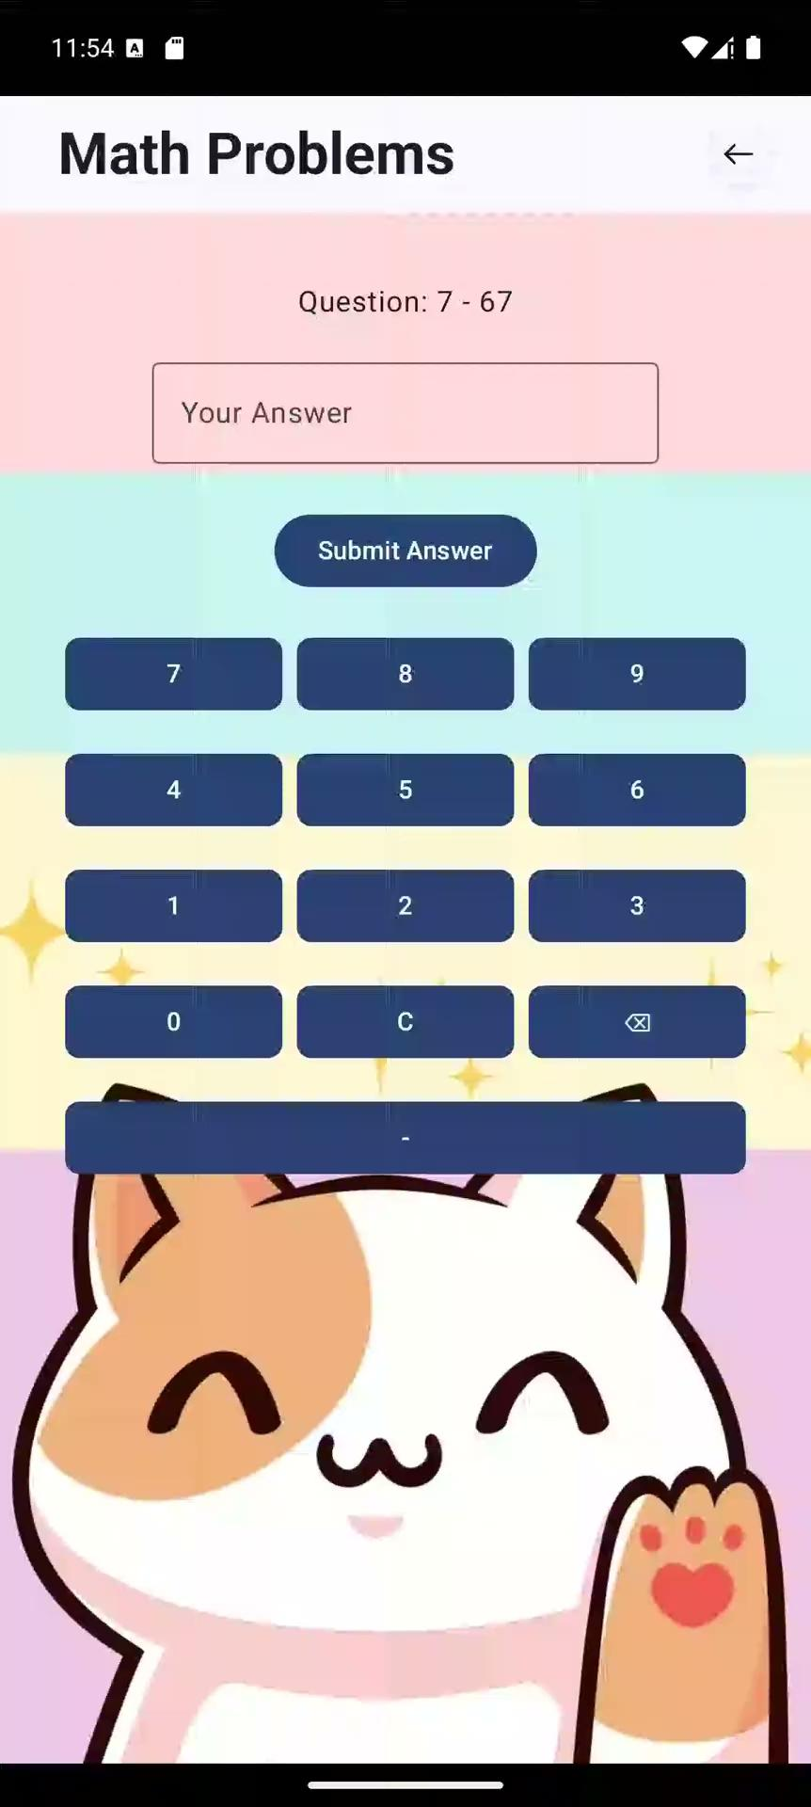
Math Problem Mode
As a user, I want to use the math problems mode to teach me basic math operations.
Questions shall be two variable equations which will include addition and subtraction.
Questions shall be randomly generated, and will be sanity checked to ensure that there are no invalid equations.
Upon answering incorrectly, a popup will display a cat fact as well as the correct answer, giving the user an opportunity to learn.
Upon answering correctly, the user will gain some XP, and a popup will display a random fun fact about cats.

Slide 8
Math Drills Mode
As a User, I want to use the Math Drill mode to test my ability to quickly solve simple math questions.
The Math Drills mode shall operate on a 60 second timer.
Upon answering incorrectly, the game mode will end, and the user will receive some XP and a fun fact.
When the timer runs out, the user will receive XP based on how many correct answers they had, as well as a fun fact.

Slide 9
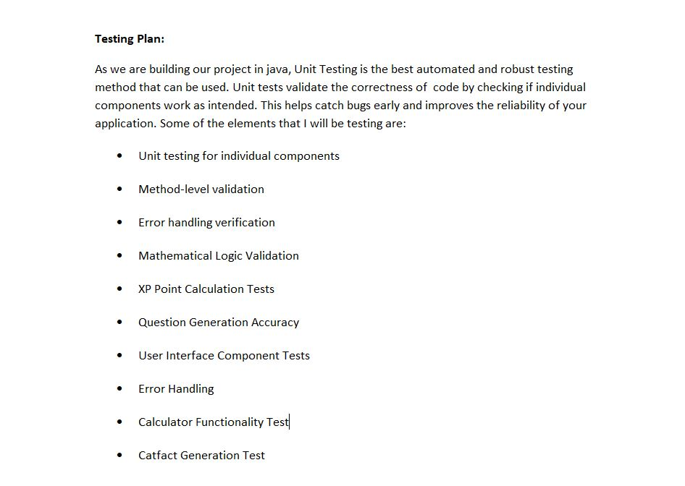
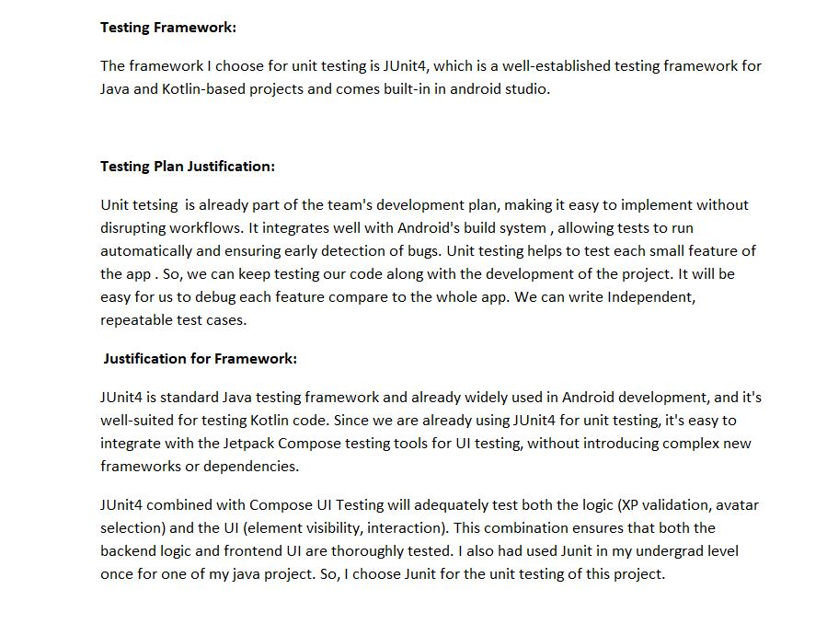
Test Plan

Slide 10
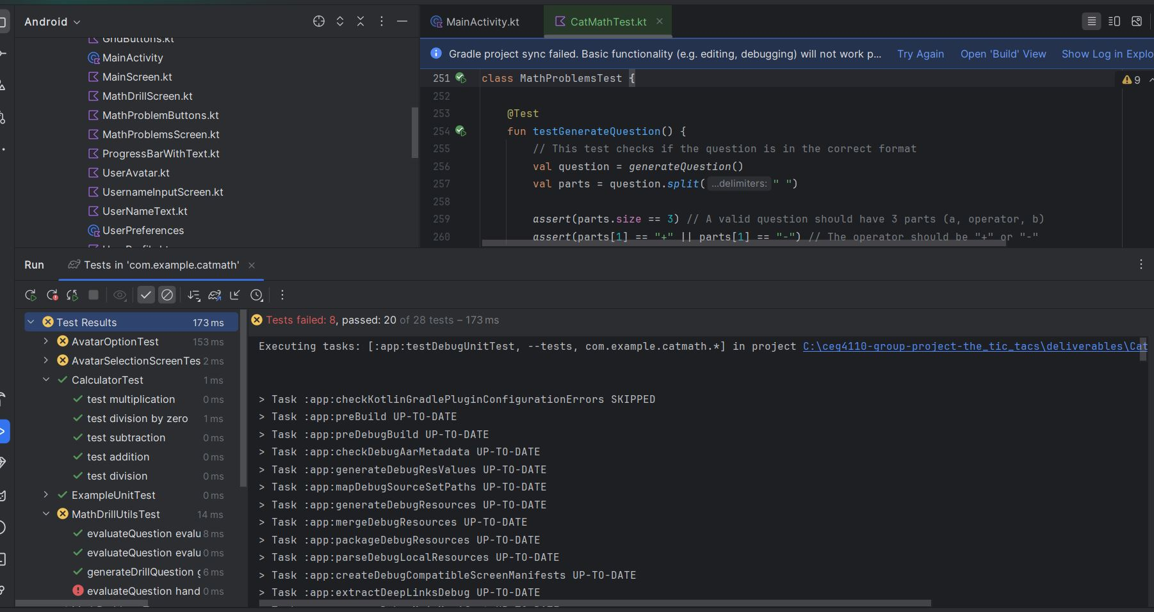
Test Sample

Slide 11
Conclusion
The application fulfills the project requirements and a few extra additions.
The project meets the needs of the users.
Overall, we we were able to implement our plans for this project. Our app is working as well as expected, we hope that users will be thrilled by it.

Slide 12
Thank You
Any Questions??

